Slide 1
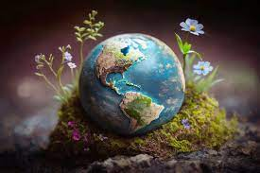
WELCOME
Ancy
CJ

Slide 2
Individual effort of mine in saving the Mother Earth.
Use bicycle
Use reusable items e.g. bottles, bags etc.
Saving energy by turning off lights and unplugging electronics when not in use.
Reduce water usage by taking shorter showers and fixing leaks.
Making wealth out of waste.
Making compost pits in each family.
Plant trees in your gardens or lands.

Slide 3
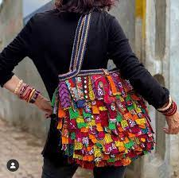
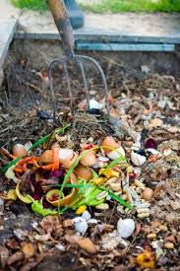
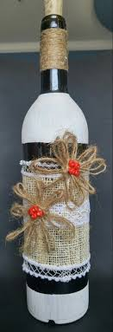
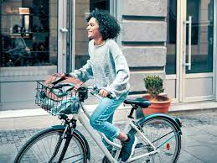
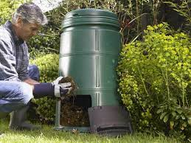

Slide 4
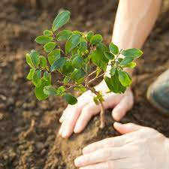
Plant trees

Slide 5
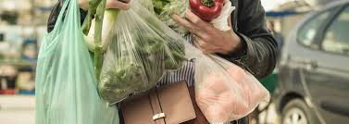
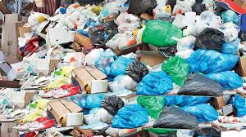

Slide 6
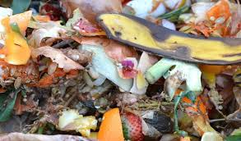
Do not throw dry leaves and kitchen waste. Turn it into wealth as a compost.

Slide 8
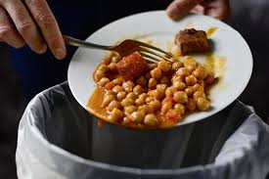
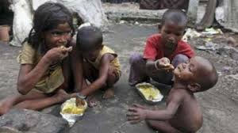
Do not waste food

Slide 9
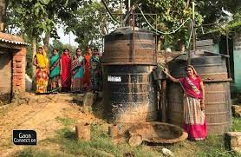
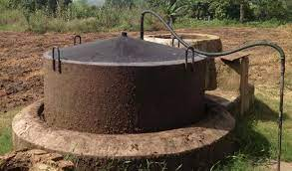
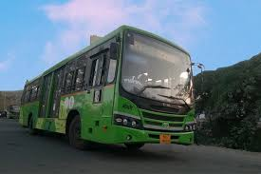
Bio Gas uses : It might be costly to install one in the beginning but once it made you can make use of it of free cost or minimum cost.
Consider your mode of travel: Use public transportation over private, sound, and air pollution decreases and uses of fuel is also saved. Even your cash.

Slide 10
Though simple steps we as responsible individual need to take it as a challenge and practice it consciously in every moment of life.
Today Can I and you see ourselves as responsible individual take a decision to practice this simple and noble steps to protect our mother earth?

Slide 11
Remember Earth does need us , we need earth and its our responsibility to protect it and make it sustainable.
Don’t see what others do but search for the possibilities of what you can do and contribute to it

Slide 12
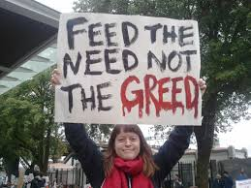
Lastly fulfill your needs not your want.
Needs are limited but wants never ends and we never get satisfied with our wants and on the process we exploit our mother earth.

Slide 13
Collective effort of Ours as an organization
Install Solar Panel for your buildings for the power supply.
Engage in awareness building activities like Street play, dance drama, go green, green, green campus cleanliness drive.
Promote Recycle, Reuse, Reduce and Refuse drive with the people you are working with.
Find volunteers to render the manual service in cleaning the public places .
Promote eco friendly life style. Like using soft wares over hard wares. E.g. digital work over paper work.

Slide 14
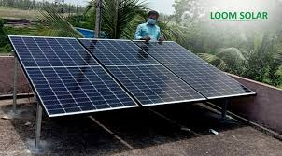
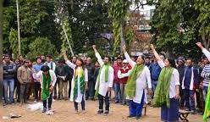
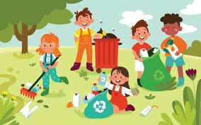
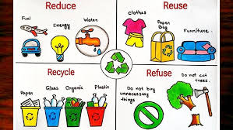

Slide 15
Educate children and youth about the resources of the earth and the danger of its becoming extinct.
Put in the values of saving and respecting the nature and resources in the heart and mind of people you are working with and for.
Observe the important days set apart to celebrate the days of environment or mother earth like 5th June.

Slide 16
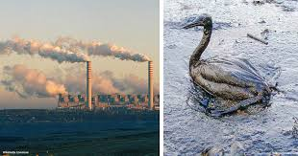
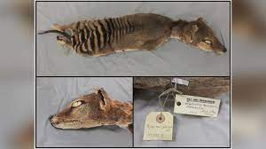
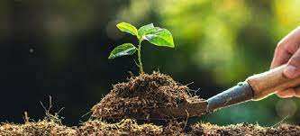
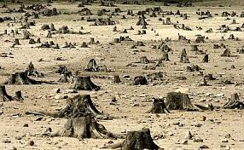
Extinct of species
Build
Do not
Destroy

Slide 17
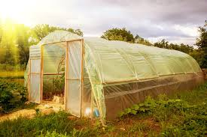
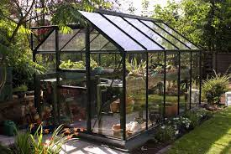
Promote organic farming.
Educate people about food chain.
Keep a pollution free campus days in a week.
Where in your campus no plastic, no vehicle or bikes which runs in fuel is taken.
Promote Green House Plantation. (FOR COLDER PLACES)

Slide 18
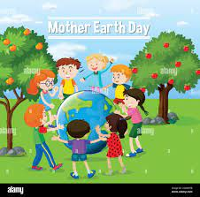
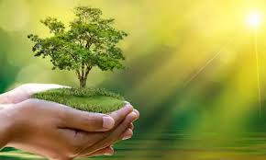
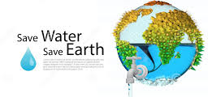
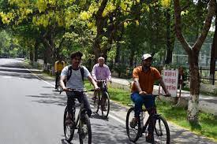
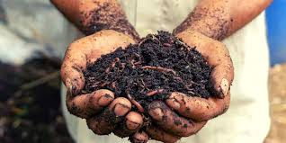
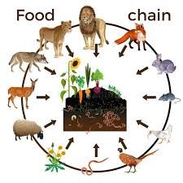
PLANT
TREES
SAVE EARTH
Pollution Free Campus Day
Organic Farming

Slide 19
The Lord, the creator asks of us, Here and Now
“To live justly, to love tenderly and to walk humbly with God.” (Micah 6:8)

Slide 20
Walk humbly with our God
We are asked to live our lives fully, to be in solidarity with those whom we are in touch, our students, parents, colleagues especially the poor and vulnerable and to bring messages of hope
We need to count our blessings thus we can share with joy, and our giving becomes meaningful.

Slide 21
Live justly
In the simplicity of our lifestyle others will experience, we live our values as educators and promoters of justice

Slide 22
Justice based action has 4 “As”–
Awareness,
Analysis,
Association
Action

Slide 23
We should then ask ourselves………!
If not Now
Then when?
If not Here
Then Where?
If not We
Then Who?
If not for A New Future
Then for What?

Slide 24
Yes, the time is now
Yes, we are the generation
We are the chosen ones

Slide 25
UBUNTU

Slide 26
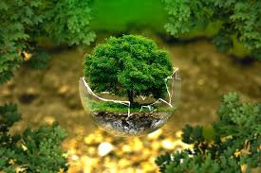
THANK YOU ! SAVE EARTH SAVE LIFE !

